Slide 1

CNN vs ANN
Comparing Cnn vs ann for image classification

Slide 2
INDEX
Image Classification
What is CNN?
CNN Model
What is ANN?
ANN Model
Compare the Model

Slide 3
IMAGE CLASSIFICATION
Image classification is a computer vision task where a model learns to categorize images into predefined classes. The goal is to assign a label to an entire image based on its visual content, which is critical in applications such as medical imaging, autonomous vehicles, and facial recognition.
The process involves training a model using a labeled dataset, where each image is associated with a specific class. Techniques like Convolutional Neural Networks (CNNs) are commonly used due to their ability to capture spatial hierarchies in images through layers of filters, enabling the model to learn relevant features automatically.
Applications range from identifying objects in photos to diagnosing diseases from medical scans. Challenges include handling variations in lighting, pose, and occlusion, as well as ensuring robustness against adversarial attacks, where small perturbations can mislead the model.

Slide 4
WHAT IS CNN?
A Convolutional Neural Network (CNN) is a type of deep learning model specifically designed for processing structured grid data like images. It consists of multiple layers, including convolutional layers, pooling layers, and fully connected layers, which together help in automatically and adaptively learning spatial hierarchies of features from input images.
These layers apply convolution operations to the input, using filters (or kernels) to detect local patterns such as edges, textures, and shapes. By stacking multiple convolutional layers, a CNN can learn increasingly complex features at different levels of abstraction.
Pooling layers reduce the dimensionality of feature maps while preserving essential information, enhancing computational efficiency and controlling overfitting. Common pooling operations include max pooling and average pooling, which down-sample the input by taking the maximum or average value in each region, respectively.

Slide 5
CNN MODEL
A CNN model is composed of several layers, including convolutional layers, pooling layers, and fully connected layers. Convolutional layers apply filters to the input data to extract features, pooling layers reduce the dimensionality of the data while retaining important information, and fully connected layers make final predictions based on the learned features.
The convolutional layers are designed to automatically and adaptively learn spatial hierarchies of features from the input images. Filters (or kernels) slide over the input image, capturing low-level features like edges and textures in the initial layers, and more complex patterns like shapes and objects in deeper layers.
The CNN model is trained using a labeled dataset through a process of backpropagation and optimization. The model's weights are adjusted to minimize the difference between its predictions and the actual labels. Techniques like gradient descent are used to optimize the weights, improving the model's accuracy over time. Regularization methods such as dropout and batch normalization are often used to prevent overfitting and enhance generalization.

Slide 6
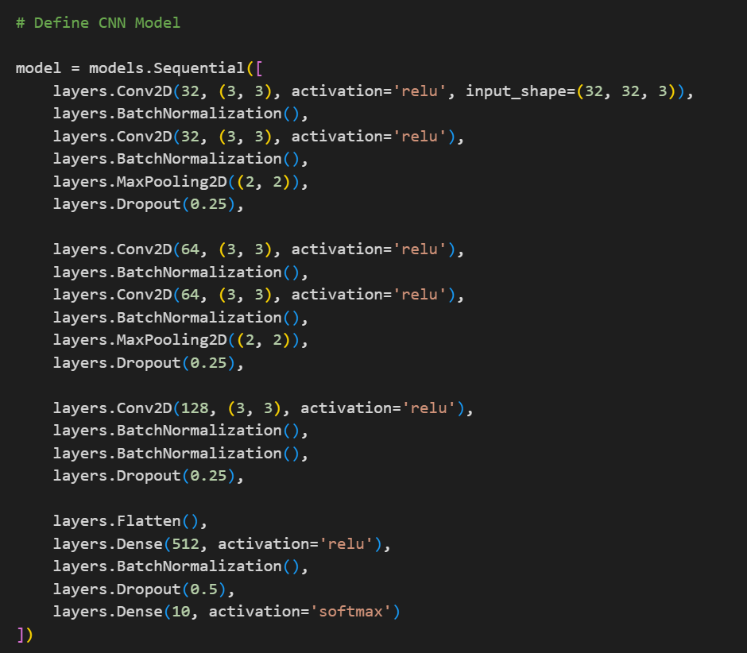
CNN MODEL

Slide 7
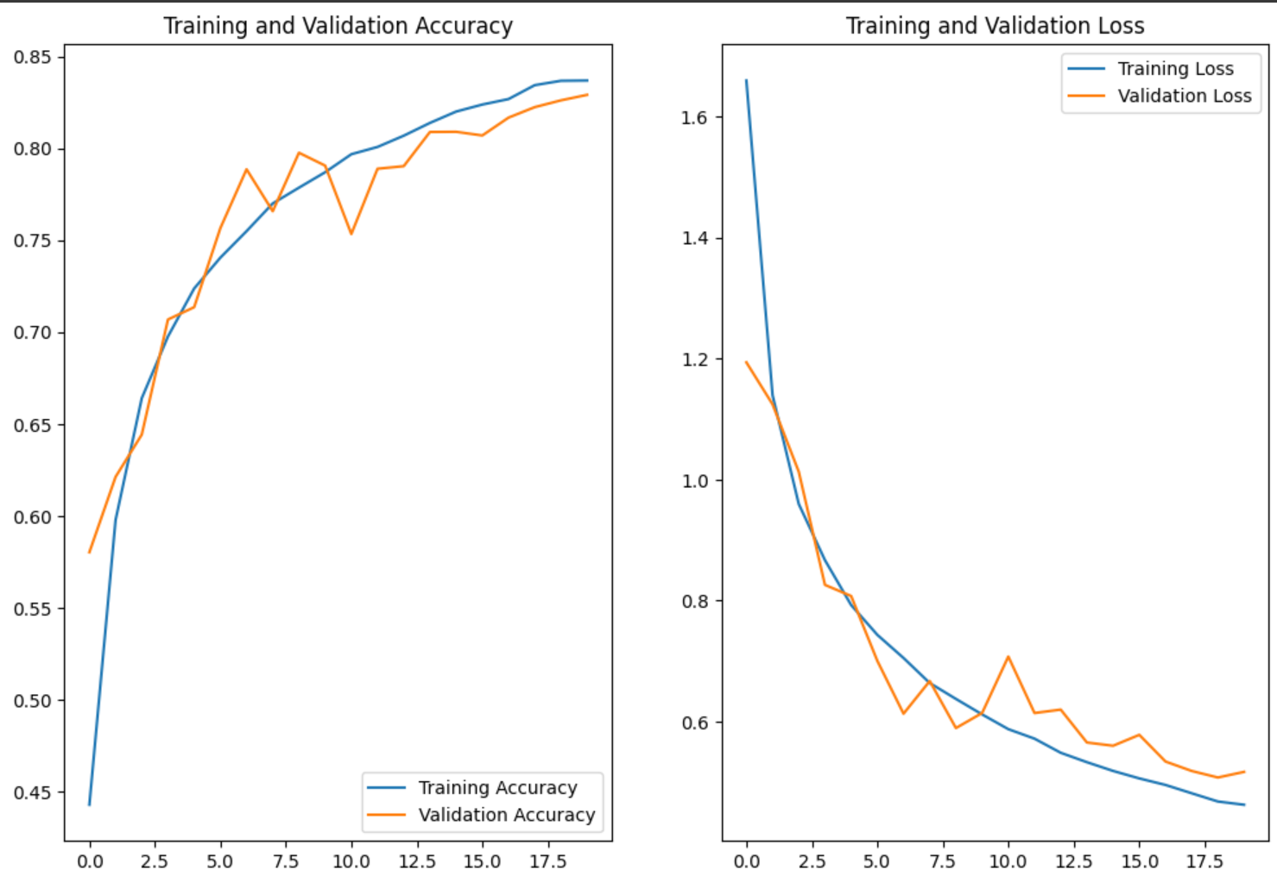
CNN OUTPUT

Slide 8
WHAT IS ANN?
An Artificial Neural Network (ANN) is a computing system inspired by the biological neural networks of animal brains. It consists of interconnected layers of nodes (neurons) that process input data, each layer transforming the data in some way before passing it to the next layer. The basic structure typically includes an input layer, one or more hidden layers, and an output layer.
ANNs learn to perform tasks by adjusting the weights of the connections between neurons based on the data they process. This learning process, often called training, involves using algorithms like backpropagation and gradient descent to minimize the error between the network's predictions and the actual outputs in a given dataset.
ANNs are highly versatile and can be used for a wide range of applications, including classification, regression, and pattern recognition. They are the foundational building blocks for many advanced machine learning and deep learning models, including CNNs for image processing and RNNs for sequence data analysis.

Slide 9
ANN MODEL
An Artificial Neural Network (ANN) consists of layers of interconnected nodes (neurons). The architecture typically includes an input layer that receives the data, one or more hidden layers that process the data through weighted connections, and an output layer that produces the final prediction or classification.
ANNs learn by adjusting the weights of the connections between neurons based on the input data and the error of the predictions. This is achieved through a process called backpropagation, which involves calculating the gradient of the loss function with respect to each weight and updating the weights using optimization techniques like gradient descent to minimize the error.
ANNs are highly adaptable and can be used for various tasks such as classification, regression, and pattern recognition. They are foundational models in machine learning and serve as the basis for more complex neural networks like Convolutional Neural Networks (CNNs) for image processing and Recurrent Neural Networks (RNNs) for sequence data analysis.

Slide 10
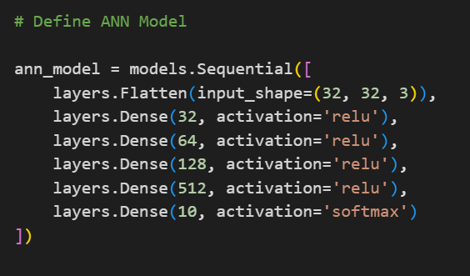
ANN MODEL

Slide 11
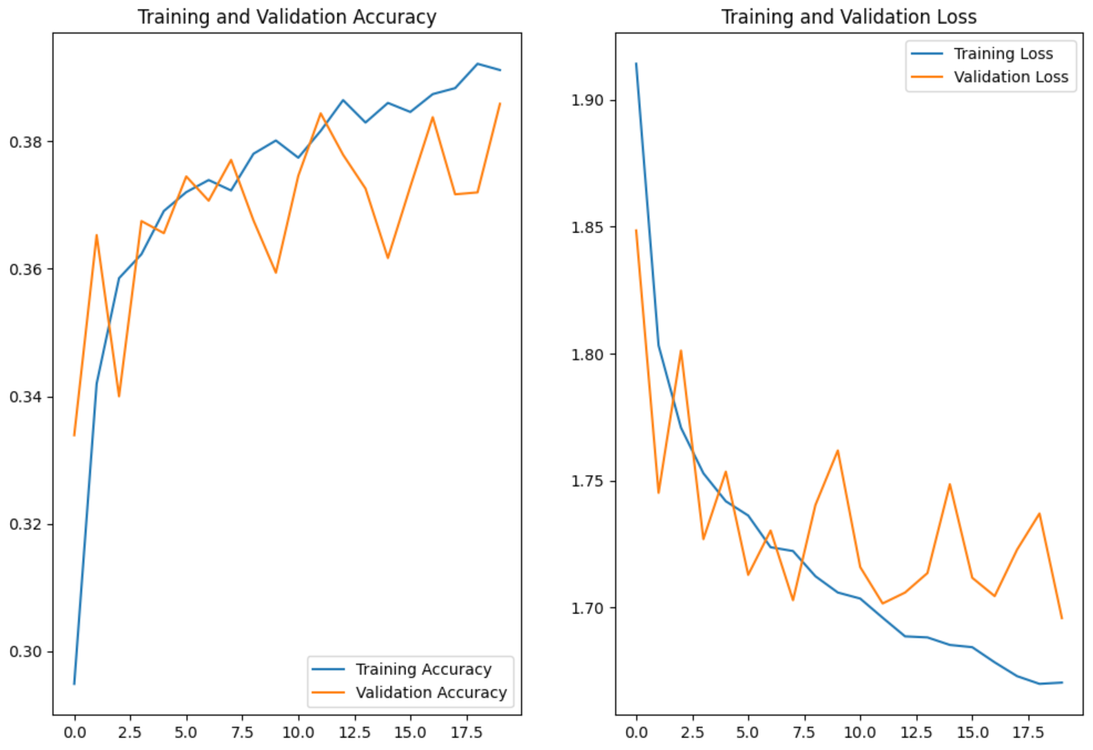
ANN OUTPUT

Slide 12
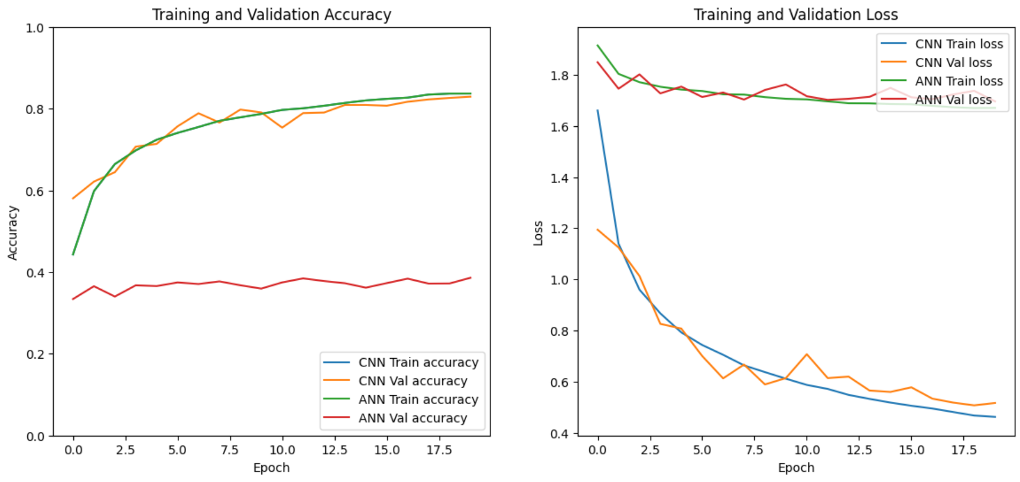
CNN VS ANN

Slide 13
The performance of CNNs is better than ANNs for image classification due to their ability to automatically learn and extract hierarchical spatial features through convolutional layers. These layers apply filters to the input image to capture local patterns like edges, textures, and shapes. By stacking multiple convolutional and pooling layers, CNNs build increasingly complex representations of the image, leading to more accurate classification. This specialized architecture reduces the number of parameters, improves computational efficiency, and enhances the model's ability to generalize to new data, resulting in superior performance compared to ANNs, which lack this feature extraction capability.
CNN IS BETTER THAN ANN (FOR IMAGE CLASSIFICATION)

Slide 14
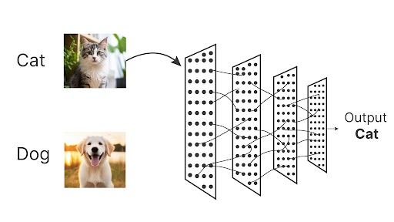
THANK YOU
LINKEDIN: Dhruv Joshi | LinkedIn
GITHUT: Dhruv Joshi | GitHub.com

